Slide 1

CROP SELECTION METHOD TO MAXIMISE CROP YIELD RATE USING LONG SHORT-TERM MEMORY NEURAL NETWORKS(LSTM-NN) TIME SERIES FORECASTING
Student Name: Shivaani Katragadda
Student Number: R00183214

Slide 2
INTRODUCTION
Agriculture is the backbone of every country. For economic growth agriculture depends on various crop types which rely on factors including weather conditions, soil classification and marketing price.
Due to improper crop selection there is a deep reduction in crop yield which leads to insecurities and food shortages that can be experienced across the world.

Slide 3
DOMAIN AND RESEARCH AREA
Data mining[1] is useful for predicting the crop yield production. It is defined as a process of finding patterns among multiple fields.
Throughout the growing and harvesting cycle of agriculture, machine learning has become popular in this multi-disciplinary agriculture domain.
The most popular models in agriculture are Artificial and Deep Neural Networks (ANNs and DL), Support Vector Machines (SVMs), Ensemble learning(EL).

Slide 4
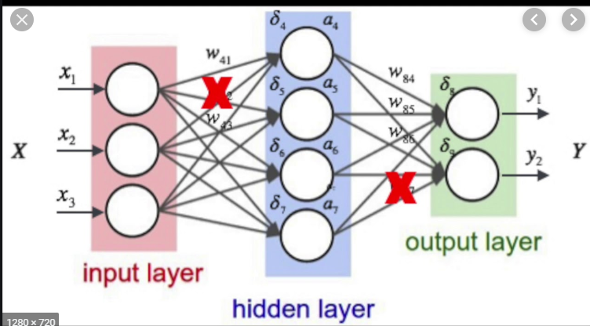
DOMAIN AND RESEARCH AREA
The primary focus of this research is to implement crop selection method to
maximize crop yield rate using deep learning architecture of ANN, Long
Short Term Memory Neural Networks (LSTM-NN) time series forecasting [3].

Slide 5
RESEARCH QUESTION
The objective of the study will be to answer the following questions concerning the study area:
Does crop production correlate with increasing population?
Is crop yield is sufficient for Population?

Slide 6
METHODOLOGY
The dataset is divided into two subsets, the first subset, comprising data from 1961–2008, is used for training the model.
The second subset consists of data from 2009–2018 used for validation purpose.
The raw data included fluctuations that might affect the forecasting results, a smoothing function is used for training the models.
One of the most widely used smoothing functions is Robust-LOWESS [4]. It uses local regression using linear recursive least squares (RLS) which decreases the effects of outliers.

Slide 7
dataset
The dataset “Production_Crops” is taken from Food and Agriculture Organization of the United Nations (FAO) [4].
The dataset consists of 51,154 entries and 123 total columns.
Crop statistics are recorded for 173 products, covering the following categories: Crops Primary, Fibre Crops Primary, Cereals, Coarse Grain, Citrus Fruit, Jute Jute-like Fibres, Oil crops Primary, Treenuts, Vegetables and Melons.
Data is expressed in terms of area harvested, production quantity and yield.

Slide 8
DATASET
Attribute No | Attribute Name | Attribute Description
1 | Area code | Area code of all countries of the world and geographical aggregates according to the United Nations M-49 list.
2 | Area | All countries of the world and geographical aggregates according to the United Nations M-49 list.
3 | Item code | Item code of each crop
4 | Item | Name of the Items
5 | Element code | Code of each element
6 | Element | Data is expressed in terms of area harvested, production quantity and yield
7 | Unit | Production Quantity and Seed: tonnes; Area harvested: hectares; Yield: tonnes per hectare.
8-123 | Y1961 to Y2018 | The year indicates that the data refer to production, yield and area harvested during the calendar year

Slide 9
REFERENCES
CITATIONS BY USING IEEE STYLE:
[1] “(1) (PDF) PREDICTING YIELD OF THE CROP USING MACHINE LEARNING ALGORITHM | IJESRT Journal - Academia.edu.” [Online]. Available: https://www.academia.edu/36345441/PREDICTING_YIELD_OF_THE_CROP_USING_MACHINE_LEARNING_ALGORITHM. [Accessed: 05-Mar-2020].
[2] “(PDF) Machine Learning in Agriculture: A Review.” [Online]. Available: https://www.researchgate.net/publication/327029380_Machine_Learning_in_Agriculture_A_Review. [Accessed: 05-Mar-2020].
[3] S. A. Haider et al., “LSTM Neural Network Based Forecasting Model for Wheat Production in Pakistan,” Agronomy, vol. 9, no. 2, p. 72, Feb. 2019, doi: 10.3390/agronomy9020072.
[4] W. S. Cleveland, “Robust Locally Weighted Regression and Smoothing Scatterplots,” J. Am. Stat. Assoc., vol. 74, no. 368, pp. 829–836, Dec. 1979, doi: 10.1080/01621459.1979.10481038.
[5] “FAOSTAT.” [Online]. Available: http://www.fao.org/faostat/en/#data/Q. [Accessed: 06-Mar-2020].

Slide 10

THANK YOU

